Slide 1
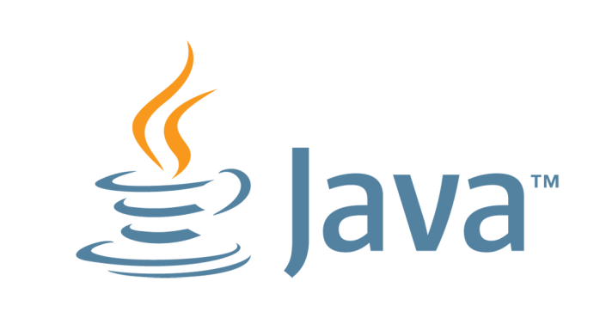

Java Fundamentals The Java Environment
CMPS 251
Read Chapters 2, 4 and 5
Unit 1_01

Slide 2
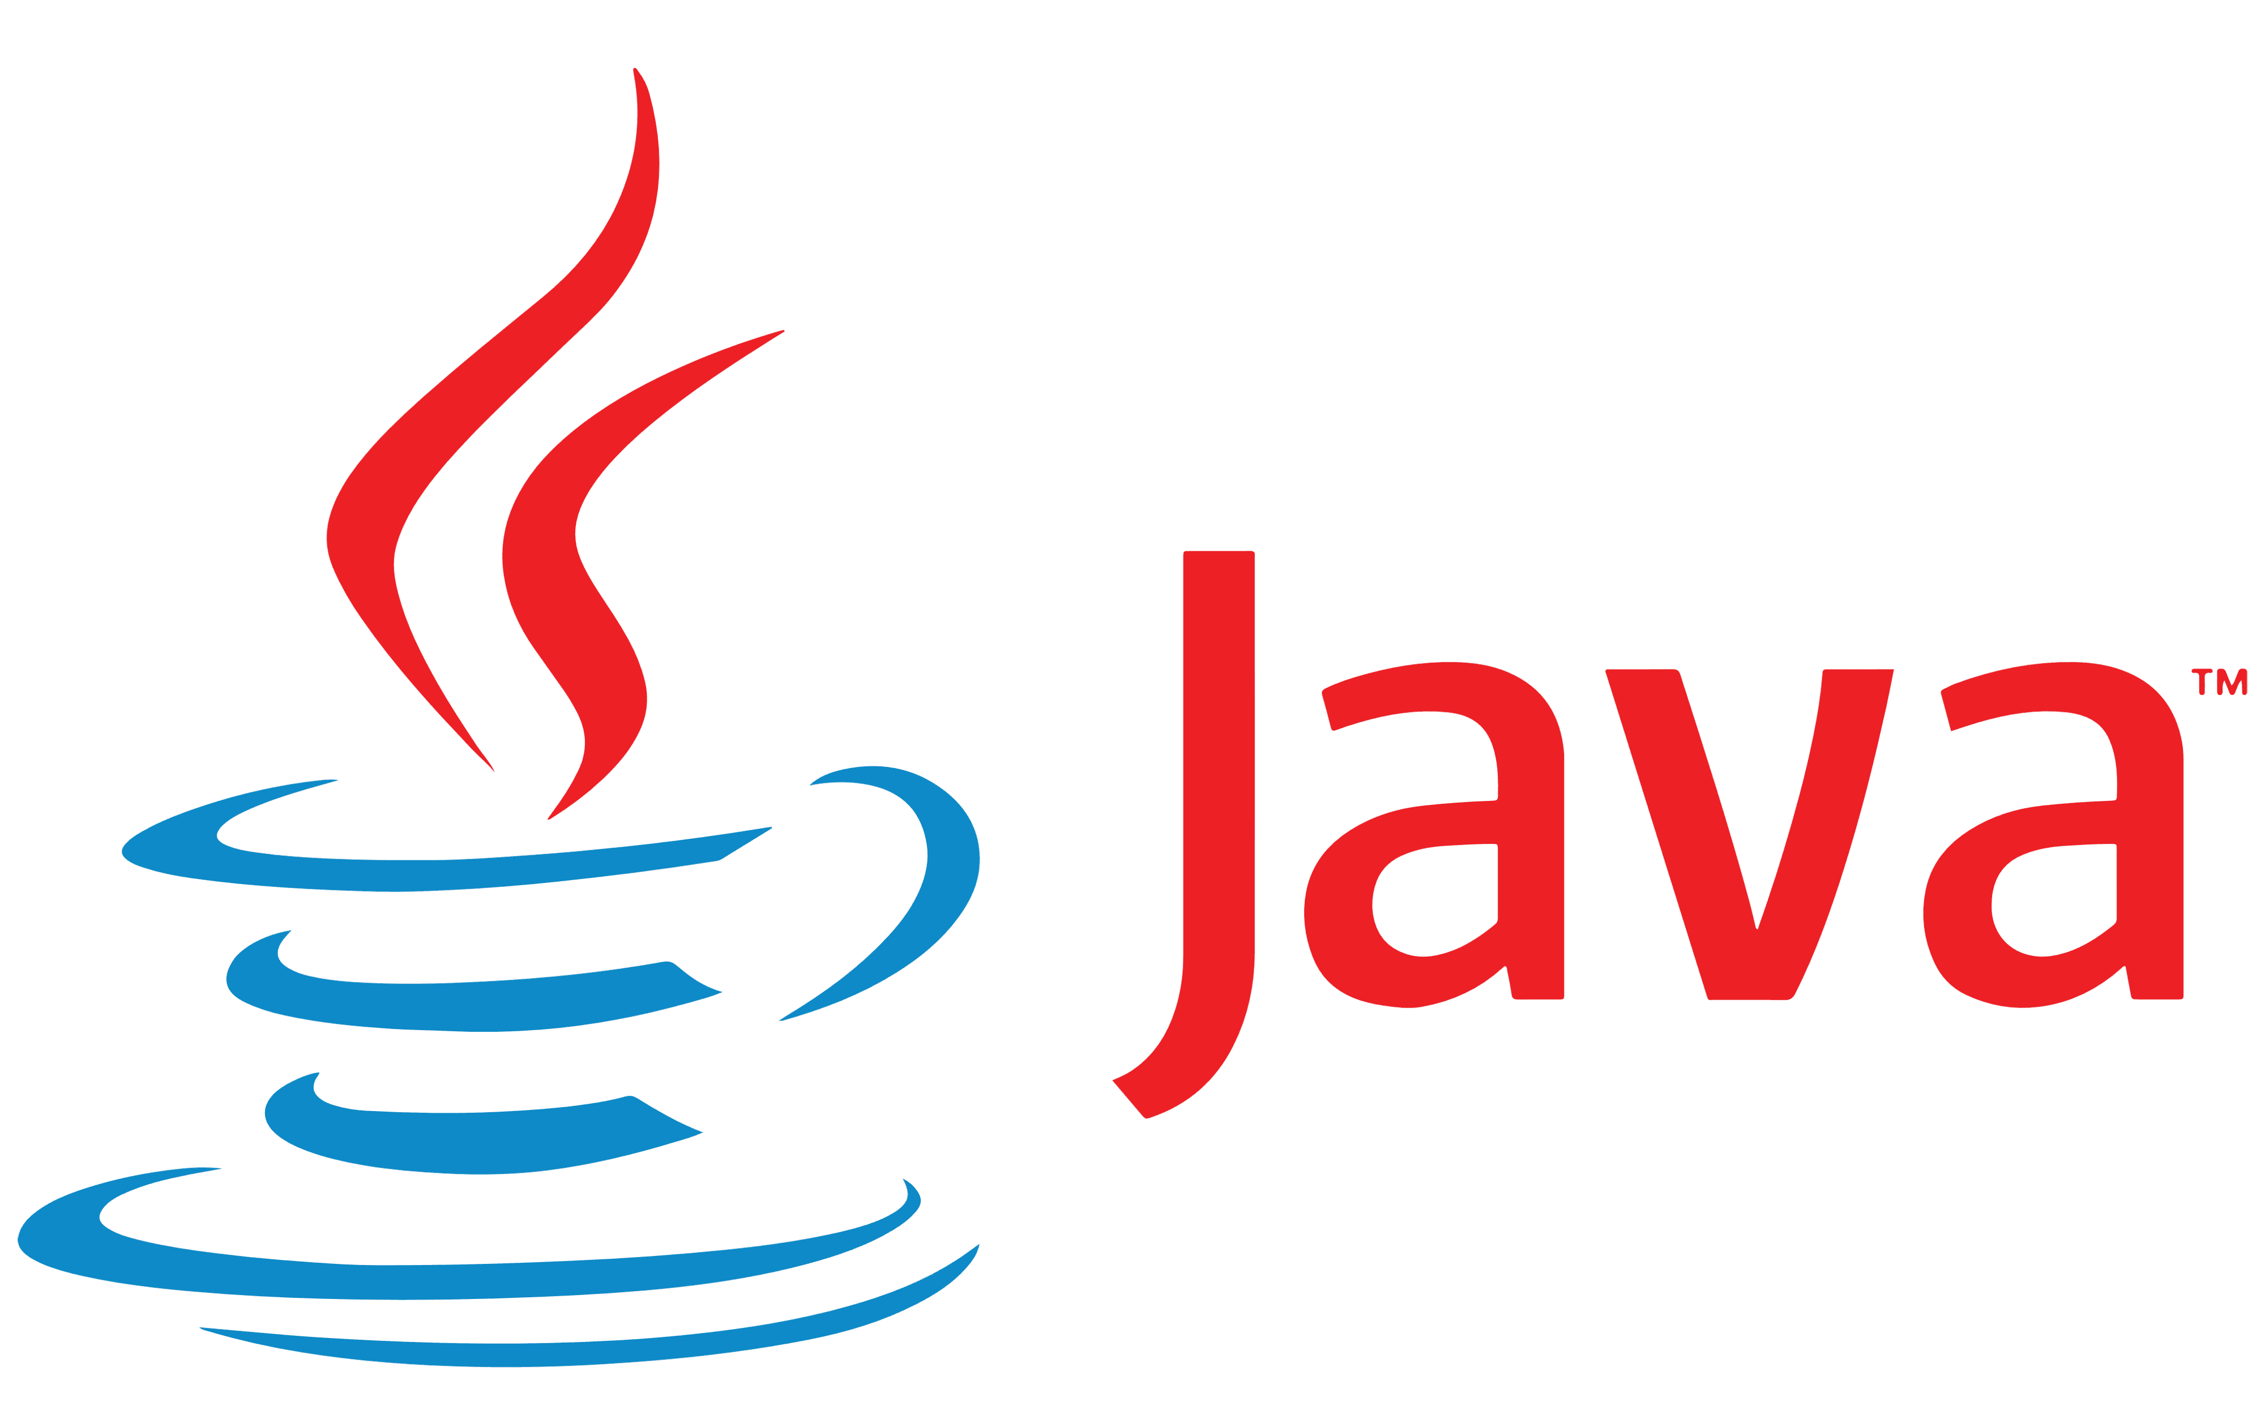
Introduction to Java
Outline
What is Java?
Java versions
Java development
Java portability
Types of errors

Slide 3
What is Java?
Java is a class-based, general-purpose, object-oriented programming language.
Originally developed by James Gosling at Sun Microsystems (1995)
Oracle acquired SUN Microsystems (2010)
Syntax is similar to C and C++ with fewer low-level facilities
The latest version is Java 21 (2024)
Very popular:
Billions of devices, 10 million developers.

Slide 4
Applications of Java
Mobile Applications
Desktop GUI Applications
Web-based Applications
Web Servers and Application Servers
Enterprise Applications
Scientific Applications
Gaming Applications
Big Data Technologies
Business Applications
Cloud-based Applications

Slide 5
Java Editions
The software you use to write Java programs is called the Java Development Kit, or JDK. Editions of the JDK:
Java SE - Java2 Standard Edition.
Java EE - Java2 Enterprise Edition.
Java ME - Java2 Micro Edition.
Available for download at http://java.oracle.com
Task 1
By next class, see LAB-1 and
Download and install the JDK
Install Eclipse and try basic programs of class 1
Bookmark the Java API documentation

Slide 6
Java Editions
Java Standard Edition (Java SE) contains the capabilities needed to develop desktop and server applications.
Java Enterprise Edition (Java EE) is geared toward developing:
large-scale applications
distributed networking applications
and web-based applications.
Java Micro Edition (Java ME) Geared toward developing applications for resource-constrained embedded devices, such as
Smartwatches
MP3 players
television set-top boxes

Slide 7
Java Development
Normally there are five phases:
edit
compile
load
verify
execute.

Slide 8
A Typical Java Development Environment
Phase 1 Editing a file with an editor program
Using the editor, you type a Java program (source code).
Make any necessary corrections.
Save the program.
Java source code files are given a name ending with the .java extension.
Integrated development environments (IDEs) provide tools that support the software development process.
The most popular Java IDEs are:
Eclipse ( http://www.eclipse.org )
IntelliJ IDEA ( http://www.jetbrains.com )
NetBeans ( http://www.netbeans.org )

Slide 9
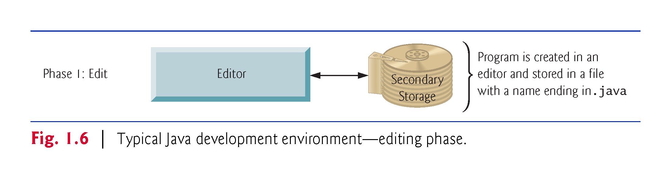
A Typical Java Development Environment

Slide 10
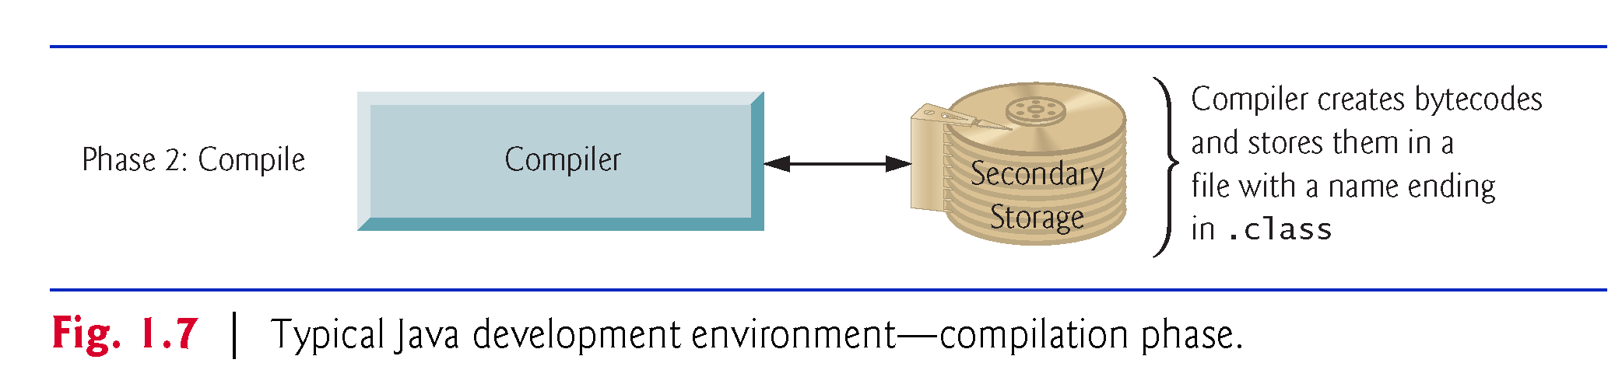
A Typical Java Development Environment
Phase 2: Compiling a Java Program into Bytecodes
Use the command javac (the Java compiler) to compile a program. For example, to compile a program called Welcome.java, you’d type
javac Welcome.java
If the program compiles, the compiler produces a .class file called Welcome.class that contains the compiled version.

Slide 11
A Typical Java Development Environment
Bytecodes?
Java compiler translates Java source code into bytecodes
Bytecode instructions are platform independent
The Java Virtual Machine (JVM)—a part of the JDK and the foundation of the Java platform—executes bytecodes.
Virtual machine (VM)—a software application that simulates a computer
Hides the underlying operating system and hardware from the programs that interact with it.
The JVM is invoked by the java command. For example, to execute a Java application called Welcome, you’d type the command
java Welcome

Slide 12
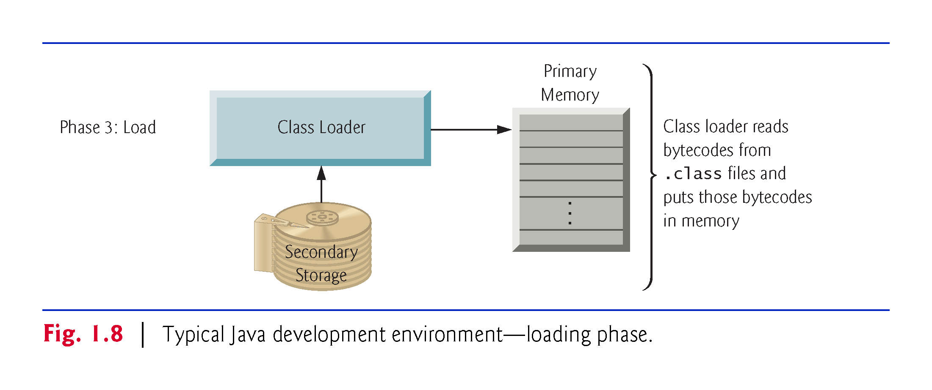
A Typical Java Development Environment
Phase 3: Loading a Program into Memory
The JVM places the program in memory to execute it—this is known as loading.
Class loader takes the .class files containing the program’s bytecodes and transfers them to primary memory. Also loads any of the .class files provided by Java that your program uses.
The .class files can be loaded from a disk on your system or over a network.

Slide 13
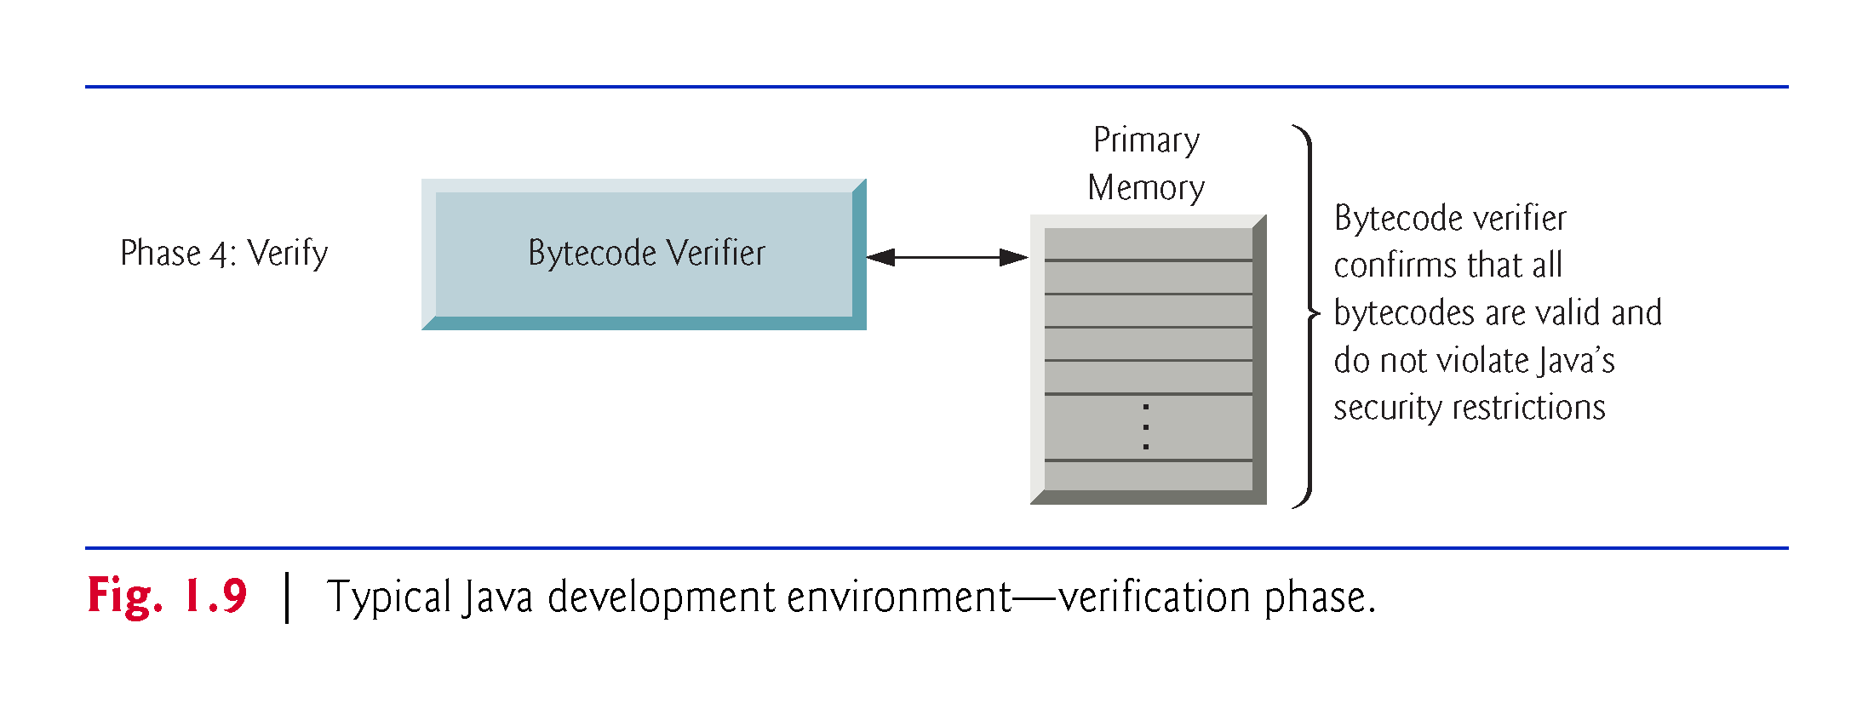
A Typical Java Development Environment
Phase 4: Bytecode Verification
The bytecode verifier examines their bytecodes ensuring that they’re valid and do not violate Java’s security restrictions.
Java enforces strong security to make sure that programs do not damage your files or your system (as computer viruses and worms might).

Slide 14
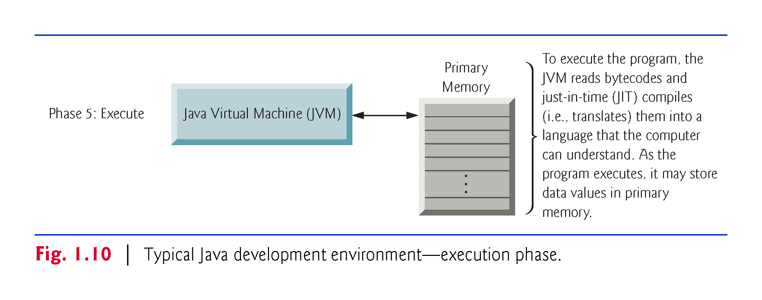
A Typical Java Development Environment
Phase 5: Execution
JVMs typically execute bytecodes using a combination of interpretation and so-called just-in-time (JIT) compilation. Analyzes the bytecodes as they’re interpreted.
A just-in-time (JIT) compiler translates the bytecodes into the underlying computer’s machine language for the actual computer on which the program. executes.

Slide 15
Program Development Process
Text editor
Saves Java statements
Source code
(.java)
Is read by
Java compiler
Byte code (.class)
Produces
Is interpreted by
Java
Virtual
Machine
Program
Execution
Results in

Slide 16
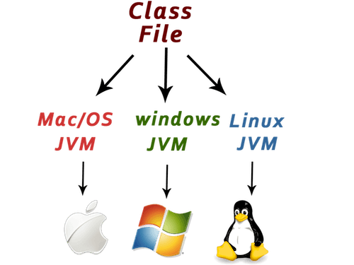
Java Portability

Slide 17
Portability in Java
While most programming languages achieve portability by compiling a program for each CPU it will run on, Java provides an JVM for each platform so that programmers do not have to recompile for different platforms.
Byte code (.class)
Java Virtual
Machine for Windows
Java Virtual
Machine for Unix
Java Virtual
Machine for Linux
Java Virtual
Machine for Mac

Slide 18
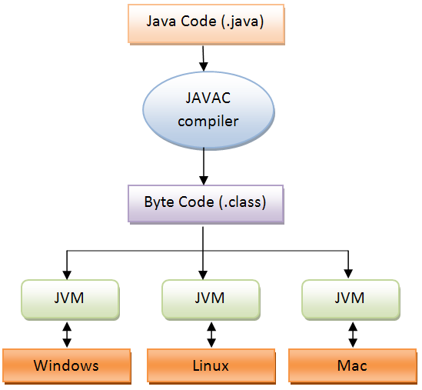
Java Compilation
Java source code is compiled into bytecode (saved in .class file)
When the program is to be run, the bytecode is converted, using the just-in-time (JIT) compiler, into executable machine code
Compile once run everywhere => better portability and security

Slide 19
Types of Errors

Slide 20
Syntax Errors
Grammatical mistakes in a program.
The grammatical rules for writing a program are very strict.
The compiler catches syntax errors and prints an error message.
Detected during compilation.
Example: using a period where a program expects a comma.

Slide 21
Runtime Errors
Detected during run time.
When the computer detects an error, it terminates the program and prints an error message.
Example: attempting to divide by 0

Slide 22
Logic Errors
Errors that are not detected during compilation or while running, but which cause the program to produce incorrect results.
Example:
An attempt to calculate a Fahrenheit temperature from a Celsius temperature by multiplying by 9/5 and adding 23 instead of 32.

Slide 23
Task 2
Download the file J1.java
Study the comments and code in this file.
Compile it and execute it as shown in the comment at the end of the program.
Try to rewrite one of your old python programs in Java.

